Slide 1
In-House Internship 2.0
(04th May – 25th June 2026)
Review-3
Department of Computer Science and Engineering
Project Title: Smart Civic Issue Reporting and Resolution System for Smart Cities.
Dr. K. Chandra Sekhar,
Associate Professor,
Department of CSE.(Guide)
Mrs.Lakshmi Kranti G, Assistant Professor, Department of CSE.(Co-Guide)
P.Bakht Singh – 24B11CS343 – CSE
Never Junior.K –24B11CS547- CSE
Budwell K.N – 24B11CS511 - CSE

Slide 2
Problem Statement
In many cities, citizens face difficulties in reporting civic issues such as:
Street light failures
Garbage overflow
Water leakage
Road damage
Drainage problems, and many more.
Existing complaint systems are often slow, unorganized, and lack proper communication between citizens, authorities, and workers. Complaints may not reach the correct department on time, causing delays in issue resolution. There is also limited transparency for citizens to track complaint progress. Manual management increases workload on municipal authorities and reduces efficiency.
Hence, there is a need for a smart digital platform that can:
Simplify complaint reporting
Automatically organize issues department-wise
Assign work efficiently
Notify workers instantly
Track complaint resolution status

Slide 3
Objective
To provide a digital platform where citizens can report civic issues, track complaint status, and receive updates while enabling municipal authorities to efficiently manage and resolve complaints.
Key Features
Online Complaint Registration
Image Upload Support
Real-Time Complaint Tracking
Department-wise Issue Management
AI-Based Complaint Forecasting
Conversational AI Chatbot
Role-Based Access Control (RBAC)
Users
Citizen – Reports civic issues, uploads evidence, tracks complaint status, and receives updates.
Admin – Monitors all complaints, manages departments, and oversees system operations.
Officer – Reviews assigned complaints and allocates tasks to field workers.
Worker – Resolves assigned issues and updates the complaint progress/status.

Slide 4
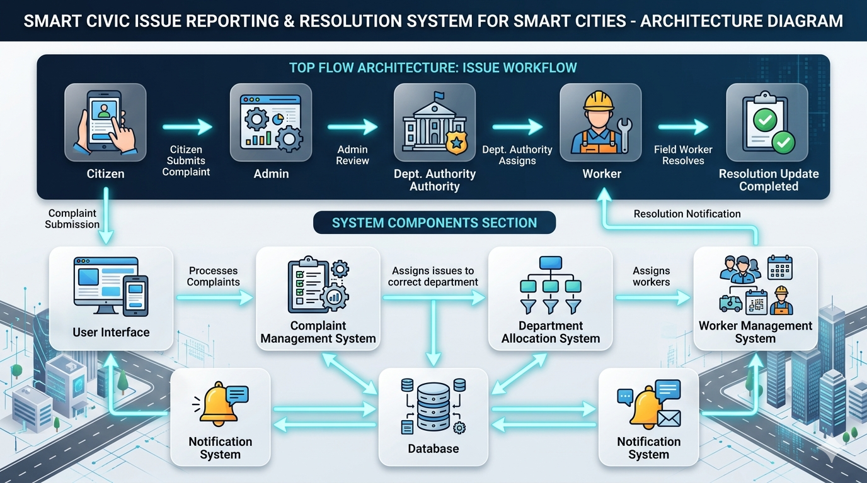

Slide 5
Technology | Purpose
React.js | Builds the interactive and responsive user interface.
React Router | Enables navigation between pages without reloading the application.
Axios | Handles communication between frontend and backend APIs.
React Leaflet | Displays complaint locations on an interactive map.
Recharts | Visualizes complaint statistics and forecasting results through charts.
Node.js | Provides the server-side runtime environment for backend development.
Express.js | Creates REST APIs and manages business logic.
JWT Authentication | Secures the system by verifying user identity and roles.
bcrypt.js | Encrypts user passwords before storing them in the database.

Slide 6
Technology | Purpose
Multer | Handles image uploads attached to complaints.
Nodemailer | Sends automated email notifications to users.
MongoDB | Stores all complaint, user, and system data.
Mongoose | Provides schema-based interaction with MongoDB.
Python & Flask | Hosts the machine learning forecasting service.
Pandas & NumPy | Process and analyze historical complaint data.
Facebook Prophet | Predicts future complaint trends using time-series forecasting.
Gemini | Powers the AI chatbot for citizen assistance and query handling.

Slide 7
Advanced Features Implemented
Geolocation & Interactive Mapping
Functionality
Browser Geolocation API captures coordinates.
Complaints displayed on map using React Leaflet.
Helps identify issue hotspots.
Machine Learning Forecasting
Workflow
Historical complaint data collected.
Data processed using Pandas.
Prophet model trained.
Future complaint trends predicted.
Results displayed using Recharts.
Benefits
Predict future issue volumes.
Better resource planning.
Proactive governance.
Duplicate Complaint Functionality
Workflow
Detects nearby similar complaints.
Groups them into Incident Groups.
Prevents duplicate work and resource wastage.

Slide 8
Conclusion
The Smart Civic Issue Reporting and Resolution System is designed to modernize the civic complaint management process through digital technology.
The project creates a direct connection between citizens, administrators, departments, and workers, ensuring:
Faster complaint handling
Better transparency
Efficient worker allocation
Improved city management
This system supports the vision of smart cities by making civic governance more responsive, organized, and technology-driven.

Slide 9


